Slide 1
How you can be the creative force in your own life
A short story about human nature
Or
The good the bad and the ugly
Or
Survival – Courage - Spirit

Slide 2
Steve
From baby to 13 years old
In this short story, there’s history, geography, humanities, maths, science, engineering and just about every other subject…

Slide 3
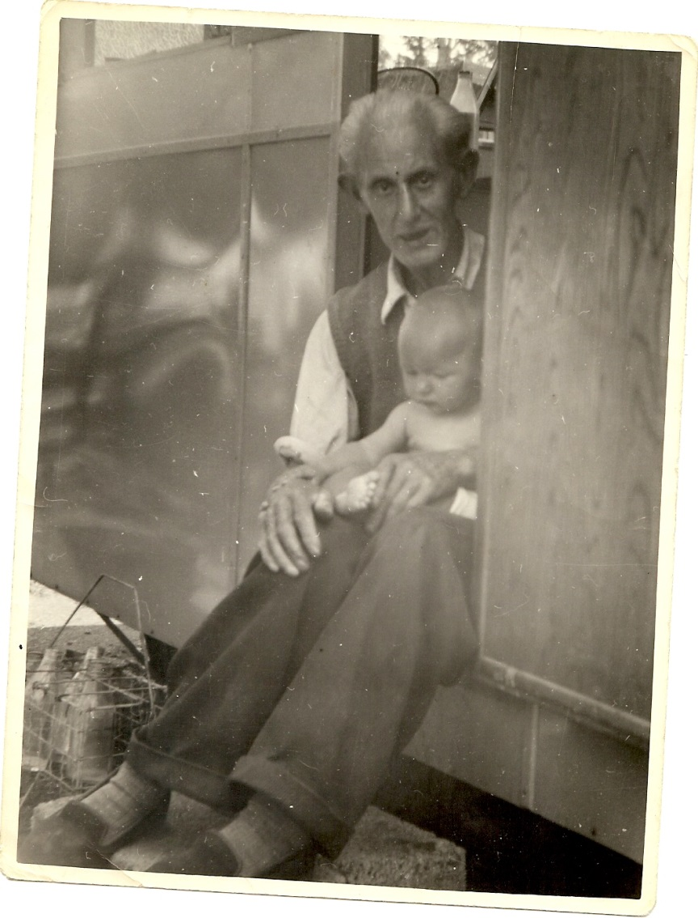
When did it all start?
1955 and the end of rationing
Yours truly with my grandfather on the step of our caravan (home)
Grandfather – Expeditionary force in 1914
Shot through the lung
Gassed
But he somehow survived

Slide 4
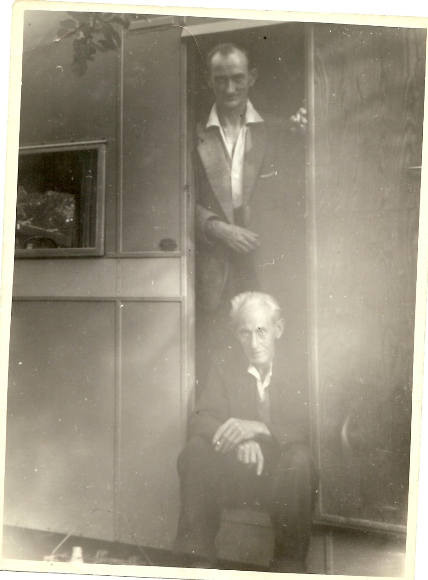
Home
My father (above) with my grandfather
The great adventure starts

Slide 5
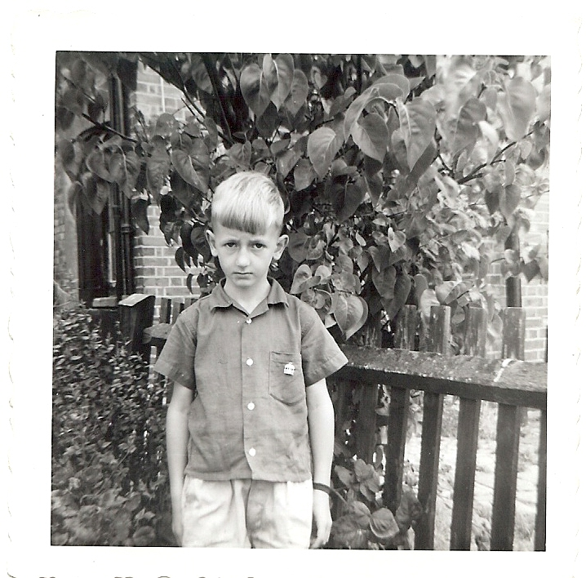
Hounslow
Yours truly looking a tad glum (but I did have hair)!
I’m innocent
Church roof
Building site
Air raid shelter
Jack frost…

Slide 6
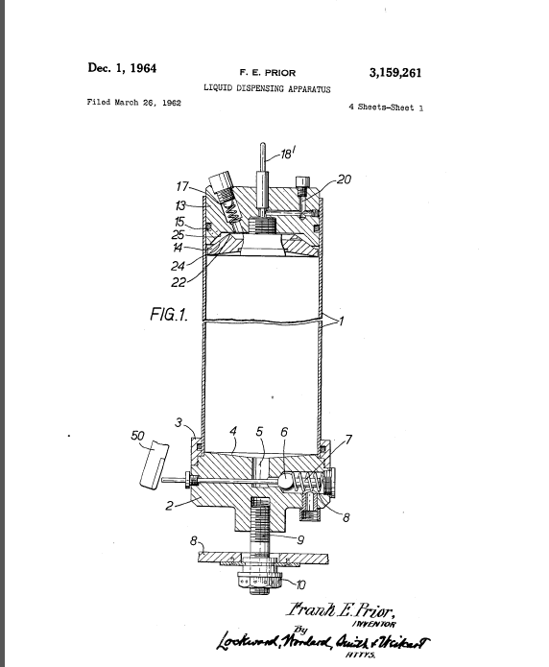
An Idea
My father had a job
+ He was an inventor
This is when the fun and games really started!
From a very cold, 47 Cecil Road, Hounslow, Middlesex to…

Slide 7
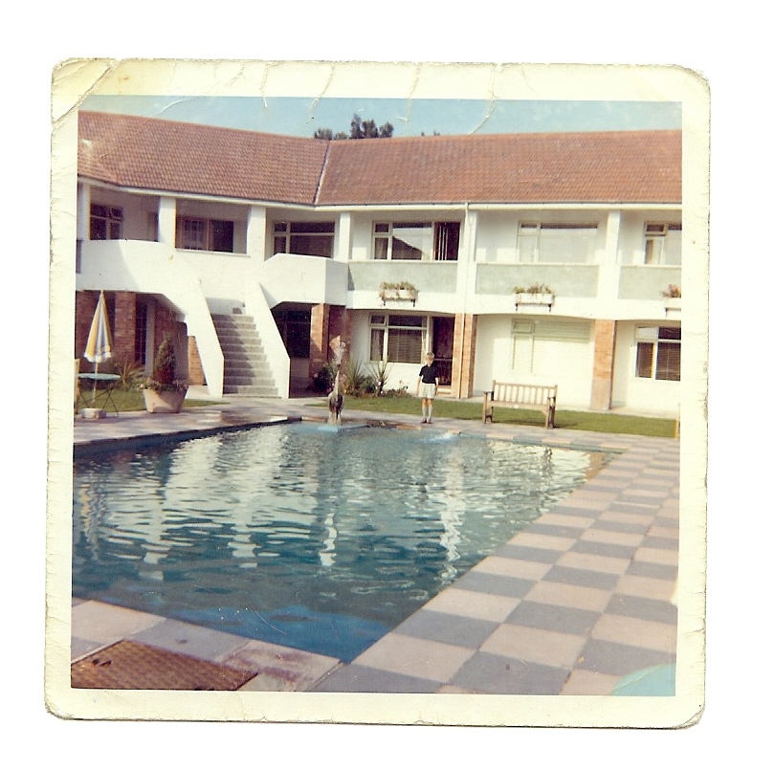
Guernsey
Apartment
Swimming pool
Huckleberry Hound
Exploration and fun
But … It didn’t work out as planned so we left and arrived in…

Slide 8
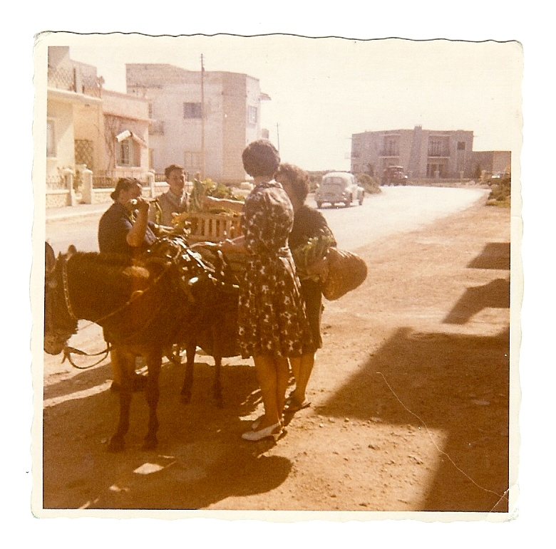
Malta
Not quite click and collect but pretty cool to have a donkey deliver your groceries

Slide 9
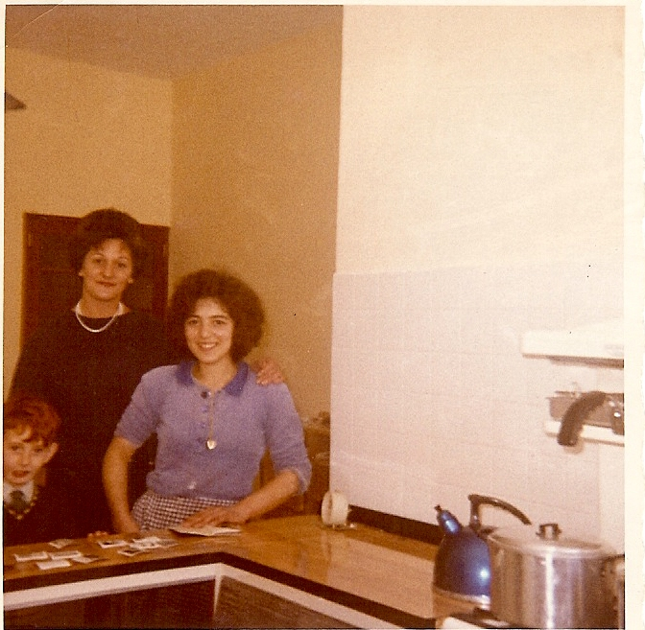
House in Mosta
Mother with my brother (Chris) and our house maid (Antoinette)
From a caravan to a palace (well almost)

Slide 10
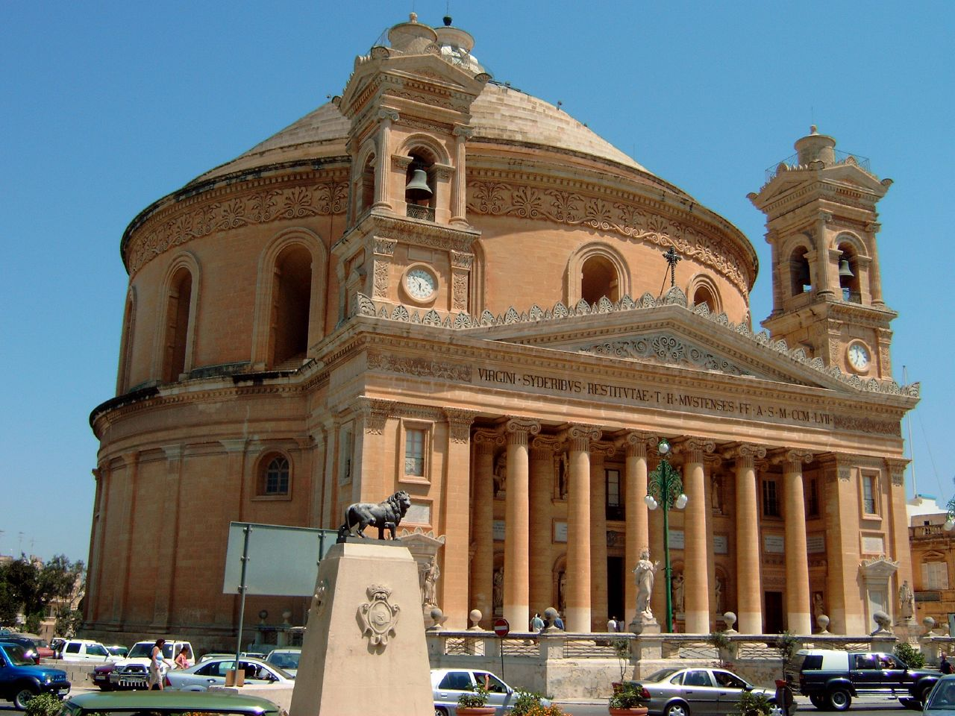
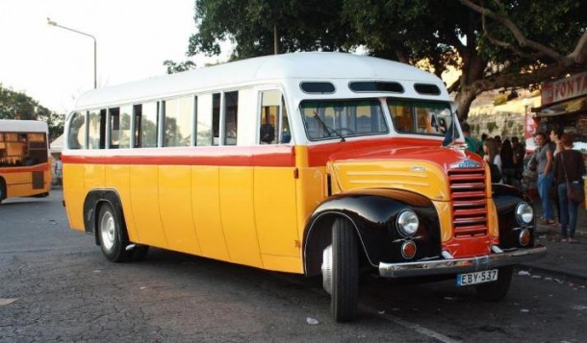
Mata’s Buses
Mosta Church

Slide 11
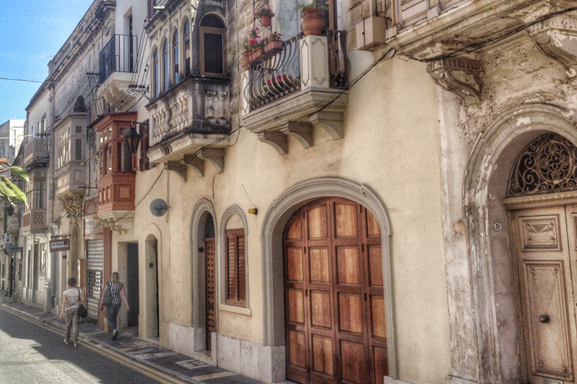
Rabat Prep-School
Run by nuns
Had a few odd ways of doing things
Breakfast – Weetabix in tea…
Drinking raw eggs
Punishment was a tad extreme

Slide 12
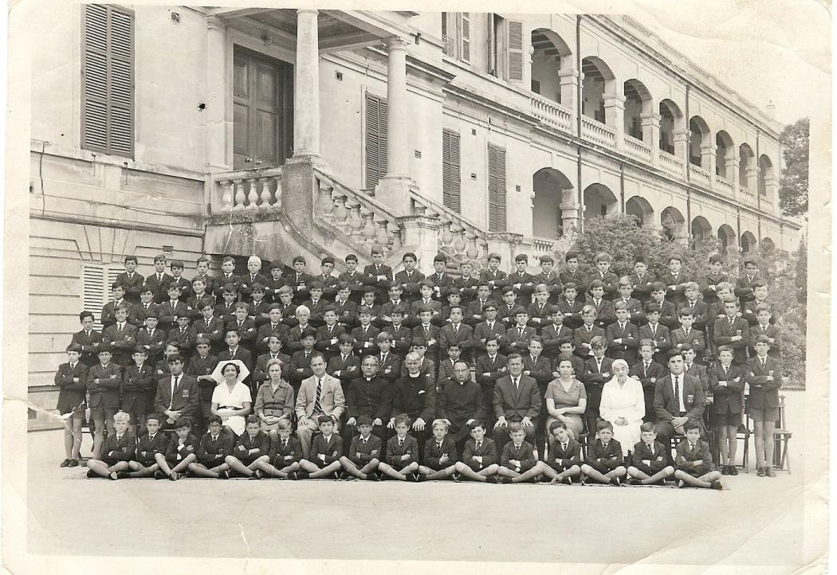
St Edwards College
Parents paid
Boarding school
Escape was futile!
Prefects ruled
Always had lines to write
I got paid for getting elicit contraband!

Slide 13
Oops!
Father turned up at school and looked dishevelled…
No car and
No more big house
In fact no more anything including my precious tape recorder
What had happened to turn our riches to rags?

Slide 14
UK Company
Stopped sending royalties to my father
No money and it was against the law to work if you were English
From a big house with marble staircase to a tiny place and …no TV
No food
But … good news

Slide 15
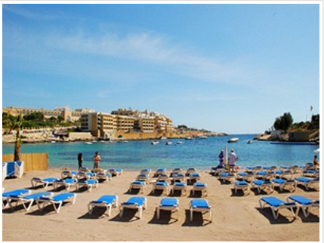
St Julians
St Georges Bay
Save the Children
Food left on doorstep
Restaurant offered meals
And I got to play in the sea all day!
Washer ladies paid for Tetanus injection

Slide 16
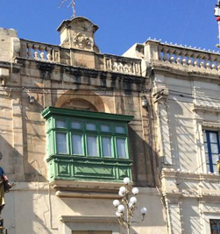
Father Returns to UK
Borrowed money from RAF benevolent fund
Got a job as a mechanic
Mother, brother and yours truly lived in Malta
Many places had these
We had great fun

Slide 17
No money but I wanted things
You need three things to create what you want
1 – A clear idea of your vision, goal, want or desire
2 – Your current reality, resources, time etc
3 – Some sort of feedback mechanism so you know if you’re on the right track or need to change things

Slide 18
Plan A
Scrounged - wood, hacksaw blades, old magazines.
Started to make wooden toys.
Didn’t always go to plan so I tweaked things until they worked
Sold toys or swapped them for the stuff I wanted

Slide 19
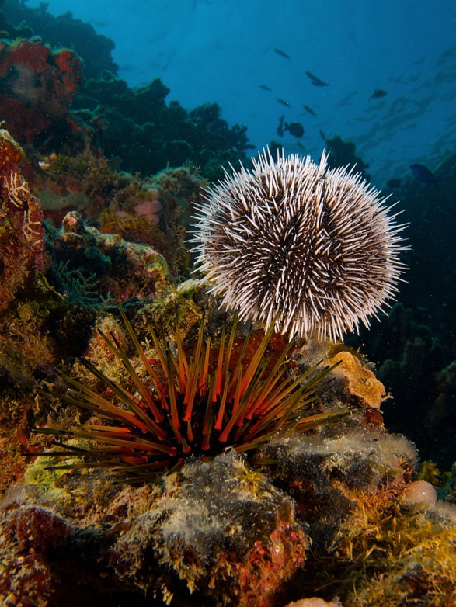
Plan B
Dived for Sea Urchins
Bath smelled a bit
After boiling them and bleaching them they became…

Slide 20
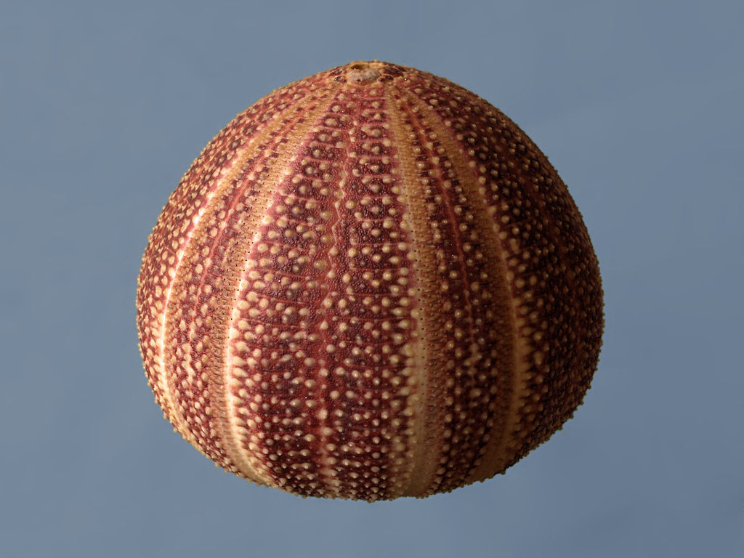
Plan B
From sharp spindles and smelly they were transformed
Bright colours and just what tourists wanted or at least that’s what I thought.

Slide 21
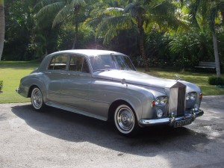
Return to the UK
How to get picked up in a film star’s Rolls Royce and Chauffeur
Rex Harrison
The connection

Slide 22
Your Great Adventure
What is your vision, goal, desire or want?
What is your current reality, resources and time?
What feedback mechanism could you use to show you if you’re on the right track?
IE, is what you are doing working or should you try another way?
Small steps

Slide 23
Help
Your vision, goal, desire or want doesn’t need to be something huge.
Start with something small just so you can get used to the approach.
You will not only survive but thrive
Hope you enjoyed my short story…
Thank you and have fun!

